Slide 1
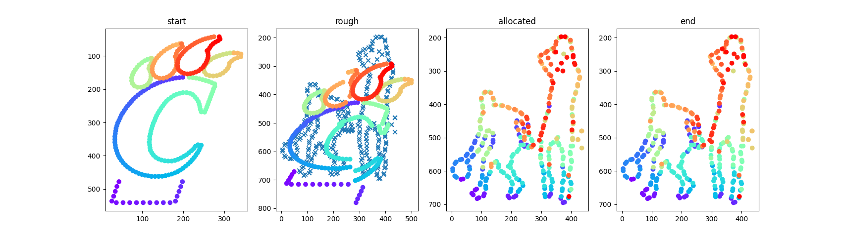
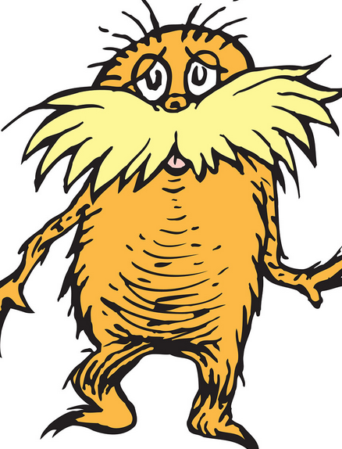

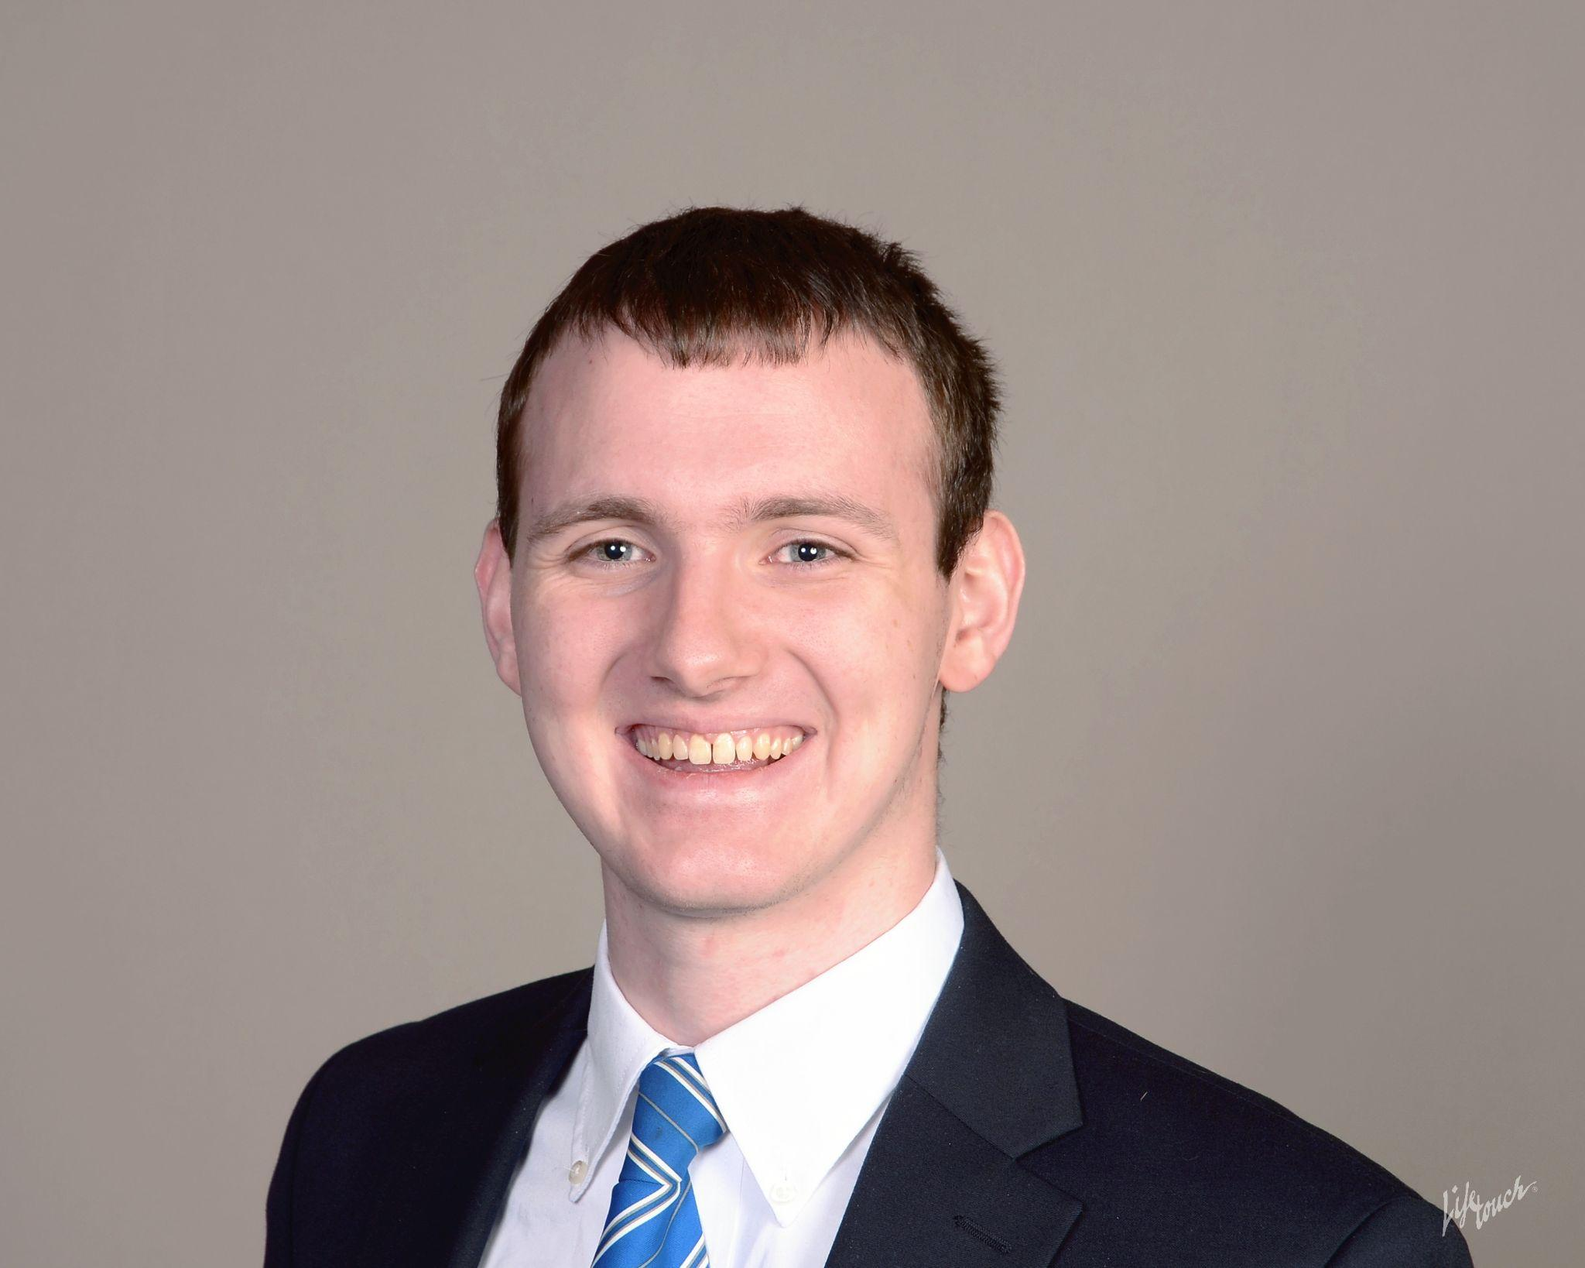
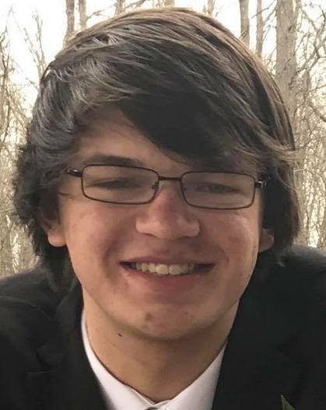

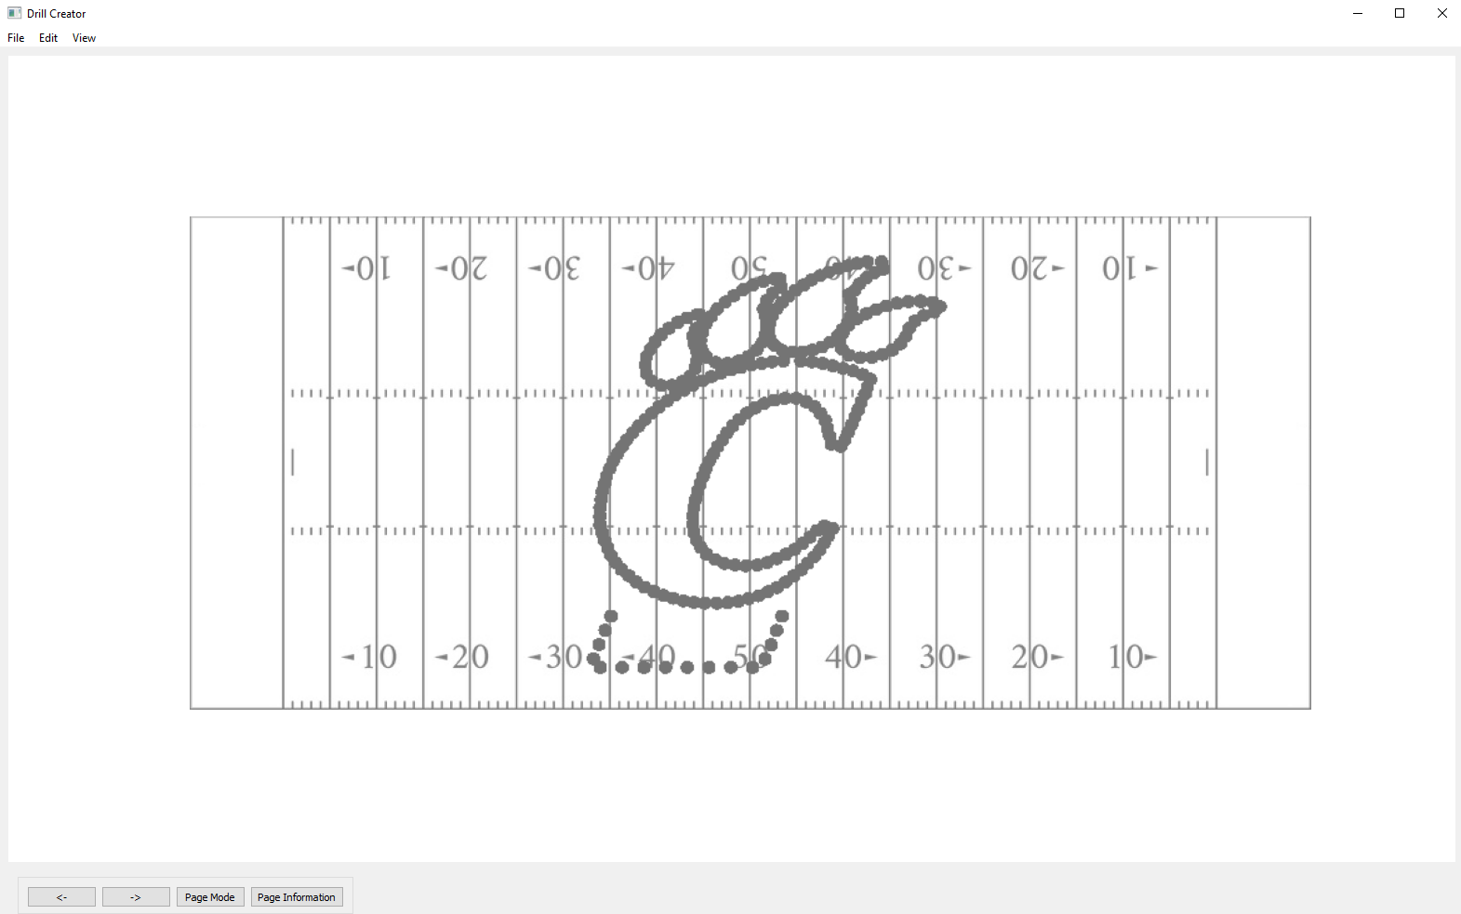
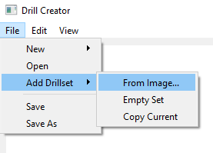


Members:
Mason Davy
Matthew Kuhr
Benjamin Middleton
Andy Greer
Drill Creator
Problem: Creating Marching Band Shows is difficult and unintuitive
Solution: Drill Editing, Image Interpretation, & Transition Solving
Results:
Advisor:
Mehdi Norouzi
Challenges:
Algorithm optimization GUI Development
Visualization of algorithm: transition from C-paw (left) to basketball players (right)
Future Improvements:
More drill move types Detailed editing features
Powered by:
Python
PyQt
Matplotlib
Interactive GUI allowing access to our tools, loading/saving/viewing shows

